Slide 1

Seminar Advanced Topics of Quantum Computing
Technische Universität München
Munich, 17. November 2023

Slide 2
Circuit Simulation Statevector simulator with Python
Student Bachelor of Business Informatics
Marina Zhdanova
Munich, 17. November 2023

Slide 3
Content of Seminar Work
Quantum circuit model in general
Quantum Information
Vectors
Unitary matrices
Quantum circuit basic gates examples
Statevector simulation on Python

Slide 4
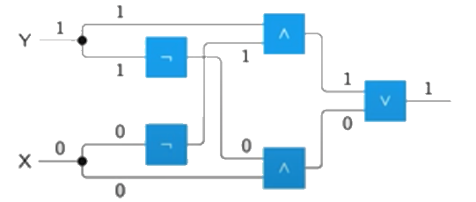
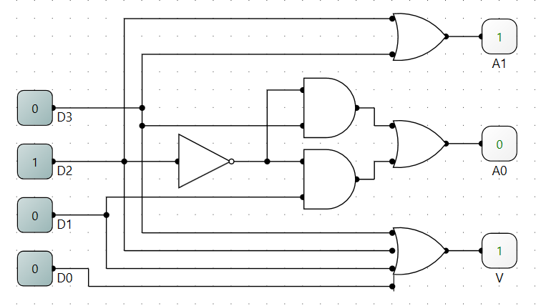
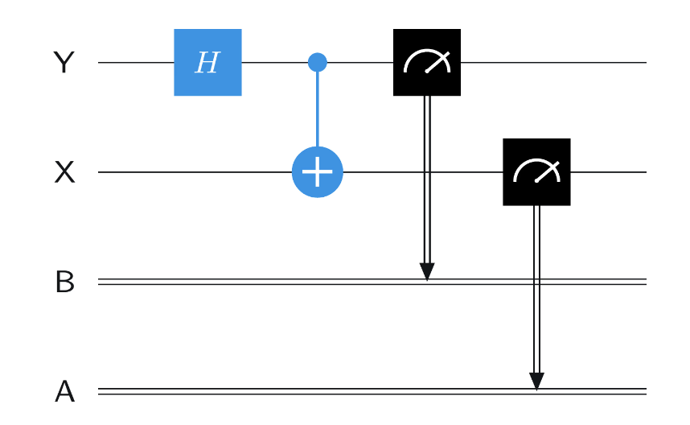
Quantum Circuits Model
Circuit – general model of computation:
Wires carry information
Gates represent operations
Circuits are always acyclic
Information flows from left to right
Boolean logic
Quantum algorithms are most commonly
described by a Quantum circuit:
Wires represent qubits
Gates represent:
unitary operations
measurements
Electrical engineering
Quantum circuit

Slide 5
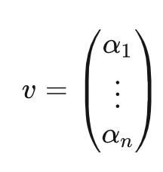
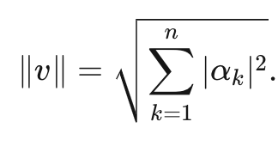
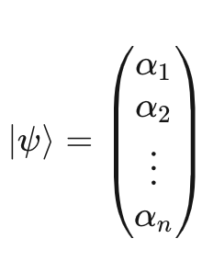
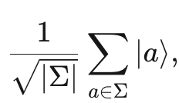
Quantum Information
Quantum states are represent by vectors, Operations are represented by unitary matrices
Standard basis measurements
Unitary operations (Gates)
Euclidean norm
Quantum state vectors
A quantum state of a system is represented by a column vector (state set Σ), similar to probabilistic states
The entries of a quantum state vector are complex numbers.
The sum of the absolute values squared of the entries of a quantum state vector is 1.
Dirac notation quantum state vector:
number of elements in Σ

Slide 6
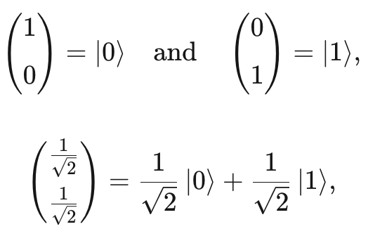
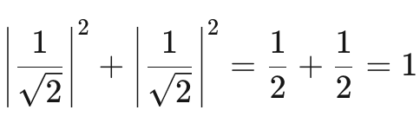
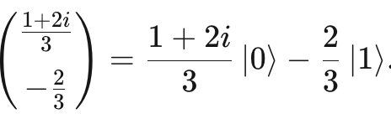
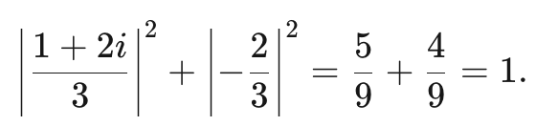

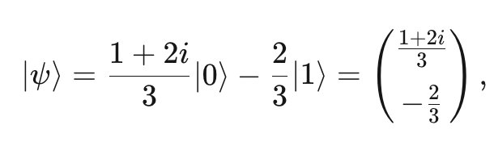
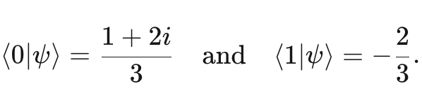
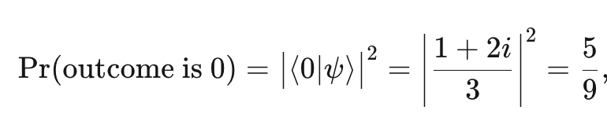
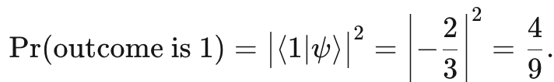
Quantum State of qubits. Measuring the Probabilities
Examples:
The notation used of arbitrary vector:

Slide 7
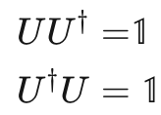
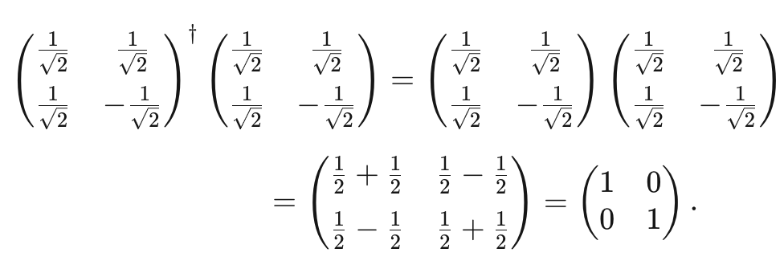
Unitary Operations
Operations on quantum state vectors are represented by unitary matrices
1 is the identity matrix, and
U† is the conjugate transpose of U
Unitary matrices are exactly the set of linear mappings which always transform quantum state vectors to other quantum state vectors
For example, here is a calculation that verifies that Hadamard* (*next slide) is unitary:

Slide 8
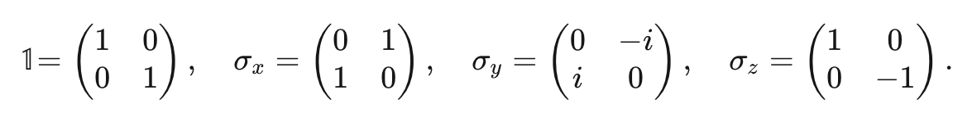


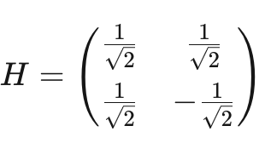
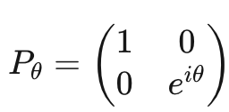
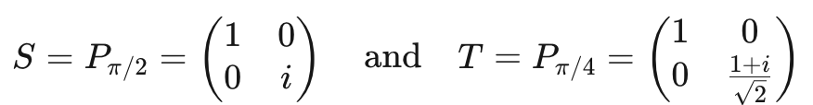
Important examples of qubit unitary operations:
Pauli operations
The X operation is also called a bit flip (NOT operation) because it induces this action on bits. The Z operation is also called a phase flip
Hadamard* operation
Phase operations

Slide 9
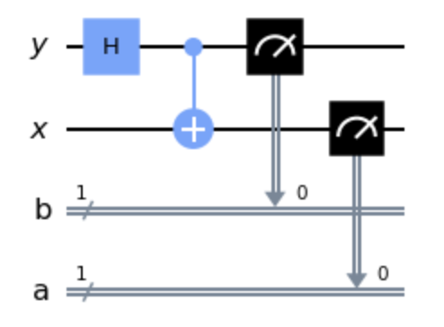
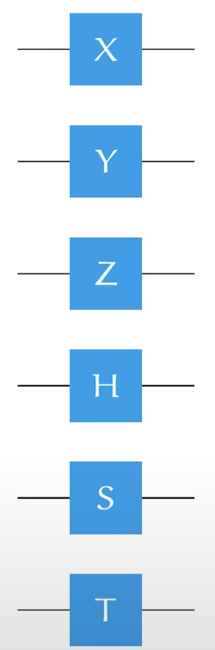


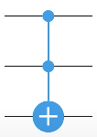
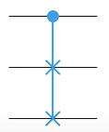
Basic Quantum Gates (=Unitary operations on qubits):
are operations applied to a qubit that changes the quantum state of the qubit for quantum computation to solve the problem
Single-qubit gates:
Multi-qubit gates:
NOT
Controlled- NOT
Swap gate
Pauli
Hadamard
Phase
**Double controlled-NOT gate (CCX),
has two control qubits and one target.
It applies a NOT to the target only
when both controls are in state ∣1⟩
Phase
Toffoli gate**
Fredkin gate

Slide 10

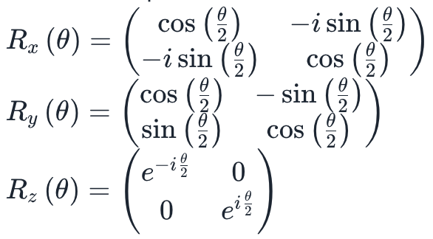
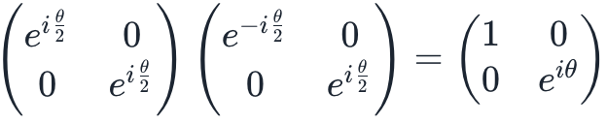
Rotation Operators
The rotation operators are defined as:
are generated by exponentiation of the Pauli matrices according to:
where A is one of the three Pauli Matrices.
Rz rotation operator can also be expressed as
which differs from the definition above by a global phase only.
Parametric gate: the matrix
depends on the parameter,
which should be passed
together with the qubits
on which the gate should act

Slide 11
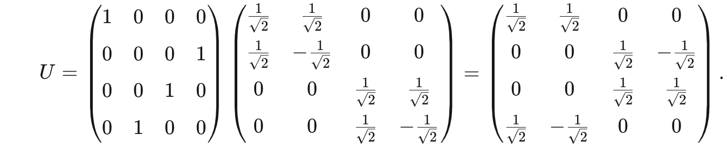
Examples of operation on information using gates
Hadamard Gate perform first operation, Controlled -NOT the second
Control- Y qubit
Target- X qubit
time
multiplication
1. Controlled-NOT
2. Hadamard

Slide 12
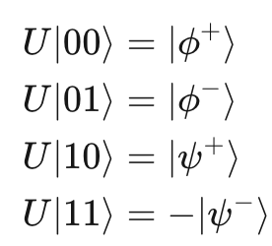
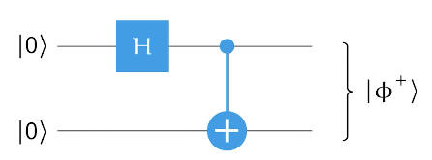
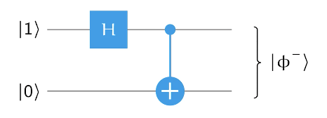
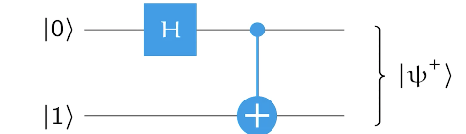
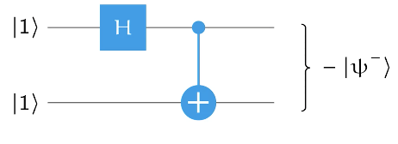
Explanation of calculations
Run qubit at ket |0>, |0>
Run qubit at ket |1>, |0>
Run qubit at ket |0>, |1>
Run qubit at ket |1>, |1>
state
Marina Zhdanova (TUM) | Tutor: M. Sc. Manuel Geiger

Slide 13
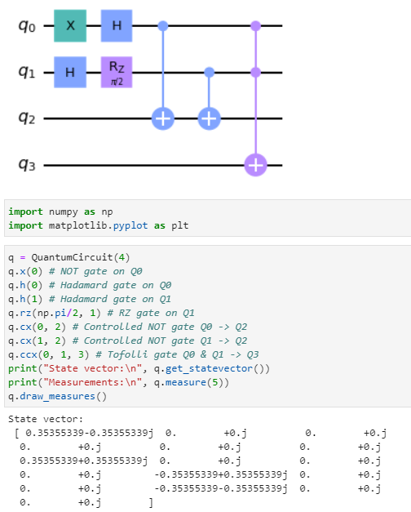
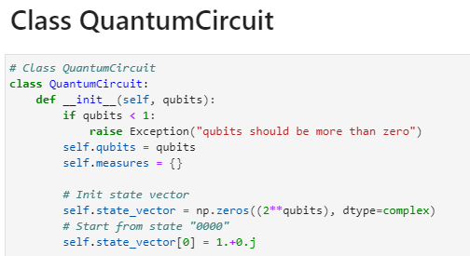
Statevector simulator with Python
I built Python statevector simulator use Qiskit as a reference to understand, what it is doing under the hood
https://github.com/MarinaZuzu/Test_-Quantum-Computing-Seminar/tree/main
Marina Zhdanova (TUM) | Tutor: M. Sc. Manuel Geiger

Slide 14
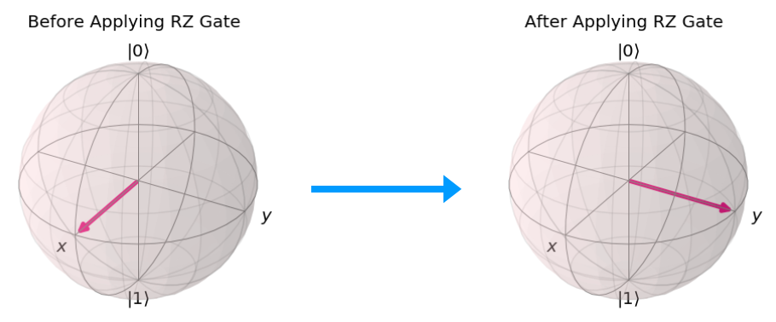

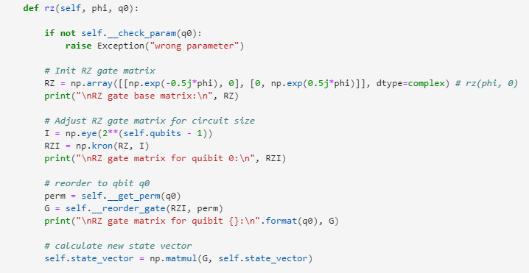
Parametric gate (RZ) simulation
The gate matrix depends on the parameter
Parameter (phi) passed together with the qubits
RZ-gate is a single-qubit rotation about the Z axis

Slide 15
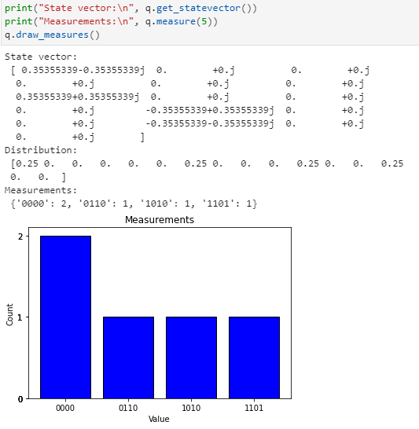
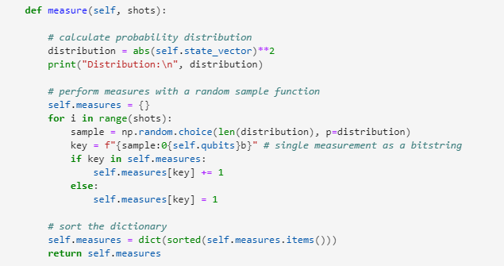
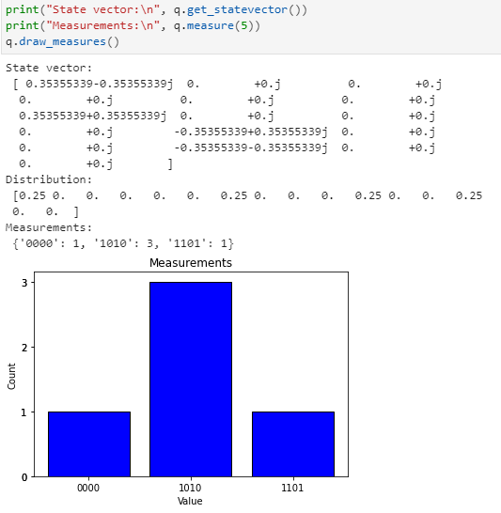
Measurement of qubit’s states simulation
Sampling from the statevector
Measure all qubits
Result of a single measurement as a bitstring

Slide 16
Thank you!

Slide 17
Literature
https://www.quantum-inspire.com/kbase/what-is-a-quantum-algorithm
https://learning.quantum-computing.ibm.com/tutorial/composer-user-guide
https://colab.research.google.com/github/MarinaZuzu/Test_-Quantum-Computing-Seminar/blob/main/sim-wrapped-inclass%20(2).ipynb#scrollTo=f3d7774f-1f7a-416d-a57a-857e84c7c0c5

